Slide 1
Artificial Intelligence
Dr. O. I. Adelaiye

Slide 2
Knowledge Representation
Lecture 5

Slide 3
Introduction
Knowledge is defined as:
Facts, information, and skills acquired through experience or education; the theoretical or practical understanding of a subject.
In order to solve the complex problems encountered in AI, one generally needs a large amount of knowledge, and suitable mechanisms for representing and manipulating all that knowledge.

Slide 4
Knowledge ?
Knowledge can take many forms. Some simple examples are:
John has an umbrella
It is raining
An umbrella stops you getting wet when it’s raining
An umbrella will only stop you getting wet if it is used properly
Umbrellas are not so useful when it is very windy
So, how should an AI agent store and manipulate knowledge like this?

Slide 5
Knowledge Representation
The object of a knowledge representation is to express knowledge in a computer tractable form, so that it can be used to enable our AI agents to perform well.

Slide 6
Knowledge Representation
A knowledge representation language is defined by two aspects:
Syntax: The syntax of a language defines which configurations of the components of the language constitute valid sentences.
Semantics: The semantics defines which facts in the world the sentences refer to, and hence the statement about the world that each sentence makes.
This is a very general idea, and not restricted to natural language.

Slide 7
Knowledge Representation
Suppose the language is arithmetic, then
‘x’, ‘≥’ and ‘y’ are components (or symbols or words) of the language
the syntax says that ‘x≥y’ is a valid sentence in the language, but ‘≥≥ x y’ is not
the semantics say that ‘x≥y’ is false if y is bigger than x, and true otherwise

Slide 8
Requirements for Knowledge Representation
A good knowledge representation system for any particular domain should possess the following properties:
Representational Adequacy – the ability to represent all the different kinds of knowledge that might be needed in that domain.
Inferential Adequacy –the ability to manipulate the representational structures to derive new structures (corresponding to new knowledge) from existing structures.

Slide 9
Requirements for Knowledge Representation
Inferential Efficiency – the ability to incorporate additional information into the knowledge structure which can be used to focus the attention of the inference mechanisms in the most promising directions.
Acquisitioned Efficiency– the ability to acquire new information easily. Ideally the agent should be able to control its own knowledge acquisition, but direct insertion of information by a ‘knowledge engineer’ would be acceptable.
Finding a system that optimizes these for all possible domains is not going to be feasible.

Slide 10
Good Representation
In practice, the theoretical requirements for good knowledge representations can usually be achieved by dealing appropriately with a number of practical requirements:
The representations need to be complete – so that everything that could possibly need to be represented, can easily be represented
They must be computable – implementable with standard computing procedures
They should make the important objects and relations explicit and accessible – so that it is easy to see what is going on, and how the various components interact

Slide 11
Good Representation
They should suppress irrelevant detail – so that rarely used details don’t introduce unnecessary complications, but are still available when needed.
They should expose any natural constraints – so that it is easy to express how one object or relation influences another.
They should be transparent – so you can easily understand what is being said
The implementation needs to be concise and fast – so that information can be stored, retrieved and manipulated rapidly.

Slide 12
Components
For analysis purposes it is useful to be able to break any knowledge representation down into their four fundamental components:
The lexical part – that determines which symbols or words are used in the representation’s vocabulary
The structural or syntactic part – that describes the constraints on how the symbols can be arranged, i.e. a grammar

Slide 13
Components
The semantic part – that establishes a way of associating real world meanings with the representations
The procedural part – that specifies the access procedures that enables ways of creating and modifying representations and answering questions using them, i.e. how we generate and compute things with the representation
In the following we shall look at these in more detail for some specific examples.

Slide 14
Knowledge Representation Using Natural Language
Humans usually use natural language (English, Spanish, Chinese, etc.) to represent knowledge, so why not use that to represent knowledge in our AI systems?

Slide 15
Knowledge Representation Using Natural Language
Advantages of Natural Language
It is extremely expressive – we can express virtually everything in natural language(real world situations, pictures, symbols, ideas, emotions, reasoning, ...).
Most humans use it most of the time as their knowledge representation of choice(how many text books are not written in natural language?).

Slide 16
Knowledge Representation Using Natural Language
Disadvantages
Both the syntax and semantics are very complex and not fully understood
There is little uniformity in the structure of sentences
It is often ambiguous – in fact, it is usually ambiguous.

Slide 17
Database Systems
Simple databases are commonly used for good effects in Computer Science. They can be used to store and manipulate virtually any kind of information
For example, the database may consist of a number of simple records stored in ASCII format:
Person record = {name : max 32 characters
age : 3 digits in range 000-127
sex : male or female
marital status : single, engaged, married, divorced, widowed
employer : company code of 3 characters
children’s names : up to 8 names each with max 16 characters}
Generally, the records can have any number of fields, containing whatever information we need, in any format, together with any appropriate links between them.

Slide 18
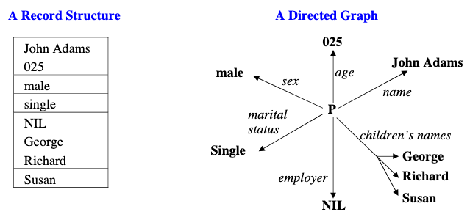
Instances in a Database Systems
Information in a database can be displayed in a variety of ways, for example:

Slide 19
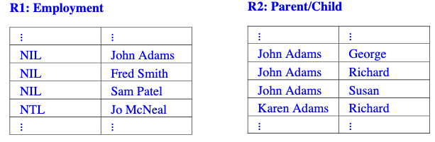
Manipulations of a Database System
We can construct sentences in an appropriate language, for example:
“marital_status(John Adams) is single” CORRECT “marital_status(John Adams) is divorced” INCORRECT SEMANTICS “marital_status(025) is male” INCORRECT SYNTAX
We can also generate relations, for example:

Slide 20
Knowledge Representation Using Databases
Traditional database systems are clearly very powerful, but for AI systems they are rather limited. The important issues are:
Advantages
Databases are well suited to efficiently representing and processing large amounts of data (and derivation from a database is virtually independent of its size)
We can build on traditional database systems to process more complex and more powerful representational devices (e.g. frames)

Slide 21
Knowledge Representation Using Databases
Disadvantages
Only simple aspects of the problem domain can be accommodated
We can represent entities, and relationships between entities, but not much more
Reasoning is very simple – basically the only reasoning possible is simple lookup, and we usually need more sophisticated processing than that.

Slide 22
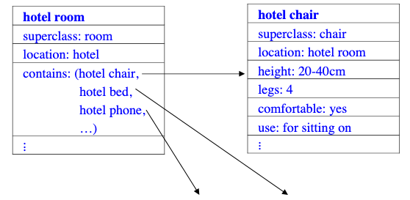
Frame Based Systems
We can extend database records to Frames consisting of slots which can be filled by values, or procedures for calculating values, or pointers to other frames. For example:

Slide 23
Frame Based Systems
Generally a whole hierarchy of frames is used to represent the required domain. It is often helpful to represent the structure of that hierarchy as a Semantic Network

Slide 24
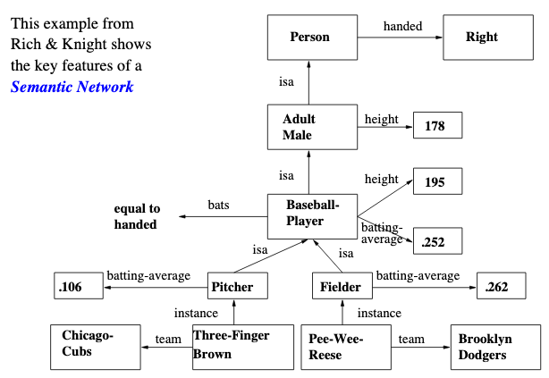
Semantics Networks

Slide 25

First Order Logic
The syntax and semantics of first order logic will be covered in detail elsewhere.
Some typical sentences in first order logic are:
man(William) ∨ woman(Susan)
married(William, Susan)
∀x∃y[person(x) ⇒ has_mother(x,y)]
∀x∀y[[parents(x,y) ∧ man(x)] ⇒¬man(y)
The language consists of constants {William, Susan, etc.}, variables {x, y, etc.},functions/predicates {Married(x,y), person(x), etc.}, and the logic symbols:
We can also manipulate the logic representations to generate new knowledge.

Slide 26
Knowledge Representation using First Order Logic
We can combine sentences by the ‘rules of logic’ to produce new sentences, e.g.
¬man(Chris)
¬man(x) ⇒ woman(x)
woman(Chris)
As a knowledge representation, first order logic has pros and cons

Slide 27
Advantages and Disadvantages
Advantages
Very expressive
Unambiguous syntax and semantics
Disadvantage
There is no generally efficient procedure for processing knowledge.

Slide 28
Rule Based System
Consists of
A database management system for handling the domain specific facts
A rule set for representing the knowledge structure/relations
A rule interpreter to carry out the problem solving.
A typical rule set might be:
R1. IF Raining ∧ Outside(x) ∧ HasUmbrella(x) THEN UseUmbrella(x)
R2.IF Raining ∧ Outside(x) ∧¬HasUmbrella(x) THEN GetWet(x)
R3.IF GetsWet(x) THEN CatchCold(x)
R4.IF Sunny ∧ Outside(x) THEN GetSunBurnt(x)
It should be easy enough to set up an appropriate database management system.

Slide 29
Rule Based Inference
If we have a knowledge base consisting of facts and rules, and a rule interpreter to match the rule conditions against the facts, and a means for extracting the rules, then we can derive new knowledge. For example, using the above rule set:
Suppose we have three initial facts: Raining, Outside(John), ¬HasUmbrella(John)
Then only the rule R2 with ‘x = John’ matches the facts, so we are able to infer
GetsWet(John). This means we now have four facts in our knowledge base: Raining,Outside(John), ¬HasUmbrella(John), GetsWet(John).
Then R3 with ‘x = John’ matches the facts, so we can also infer CatchesCold(John),and end up with five facts: the initial three, GetsWet(John), CatchesCold(John)
Note that there is no way we can end up with GetsSunTan(John)
The process of deriving new facts from given facts is called inference.

Slide 30
Knowledge Representation using Rule Based System
We can see that rule based systems have many of the properties required of a knowledge representation. However, as always, there are pros and cons
Advantages
These systems are very expressive
The rules lead to a degree of modularity
We can easily introduce procedures for handling certainty factors, and this leads to the possibility of probabilistic reasoning.
Disadvantage
There is a lack of precise semantics for the rules
The systems are not always efficient.
We shall study rule based systems in detail in a series of lectures later in this module.

Slide 31
Best Knowledge Representation
We have now seen what is required of a knowledge representation and taken a brief tour through a number of the most obviously plausible styles of knowledge representation
There are clearly many more representational formalisms that might be useful. For a start, we have only really considered symbolic representations. There also exist non-symbolic (e.g. pictorial) representations. So-called sub-symbolic representations are also possible (e.g. as one finds in the activation patterns of neural network systems)
In selecting a representational formalism one needs to consider exactly what has to be represented, and how that knowledge needs to be processed. We should also consider how the system will go about acquiring new knowledge
In practice, there is no single best knowledge representation system that can be used for everything. In building large complex AI systems, one will usually want to employ many different types of knowledge representation

Slide 32


